Slide 1
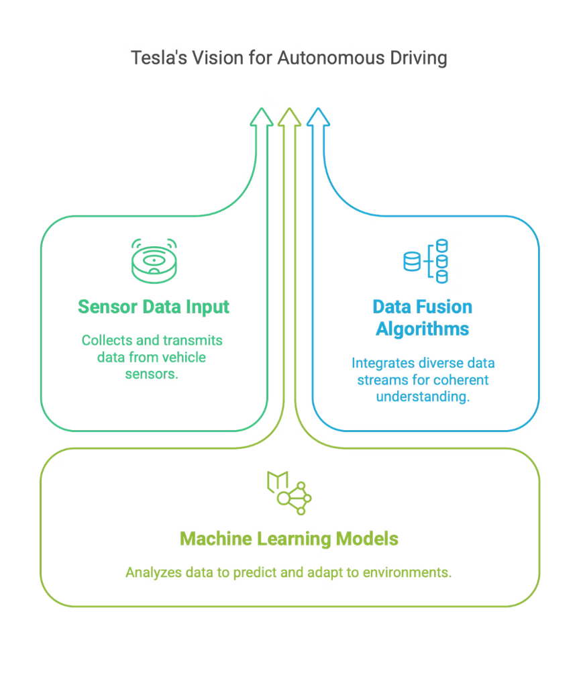

Tesla Full Self-Driving (FSD) Chip Design
Processing Data in Real-Time for Autonomous Vehicles
TEAM MEMBERS:
1
Sukhmani Thukral
Literature Review (AI accelerators and SRAM structures)
2
Namrata Mali
Architectural Analysis (Tesla's custom instruction set)
3
Likhitha Gudivada
Performance Evaluation (latency, power efficiency, fault tolerance)
4
Priyanka Jaina
Real-World Integration (FSD chip implementation in Tesla vehicles)

Slide 2
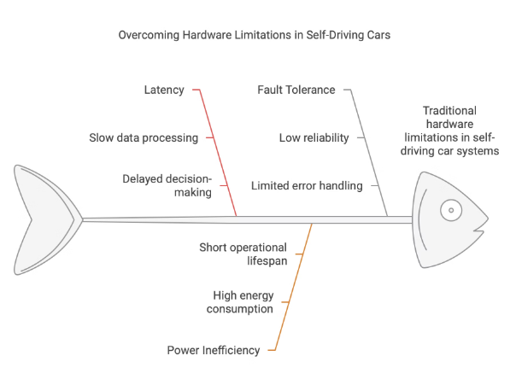
Research Overview
Real-Time Analysis
Advancement
Custom Solution
Self-driving cars require immediate sensor data analysis for safe operation.
Tesla's Full Self-Driving (FSD) chip represents a major advancement in hardware engineering.
Specifically designed for AI inference in vision and control systems.
The FSD chip addresses traditional hardware limitations such as high latency, power inefficiency, and limited fault tolerance.

Slide 3
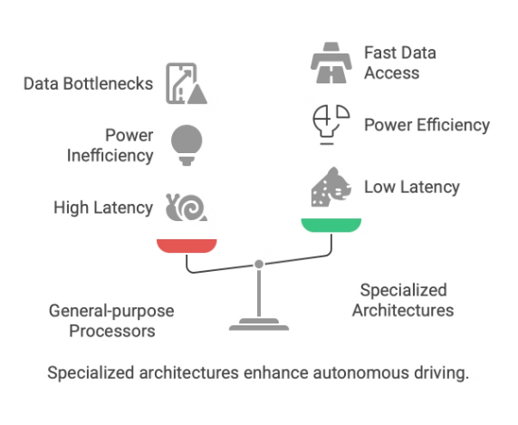
Initial Challenges in Autonomous Driving
High Latency
Power Inefficiency
Data Bottlenecks
Poor Fault Tolerance
General-purpose processors inefficient at handling high data flow.
Traditional architectures consumed significant power, limiting range and efficiency.
Non-optimized memory architectures caused delayed access to sensor data.
Conventional hardware lacked robust error detection/correction mechanisms.

Slide 4

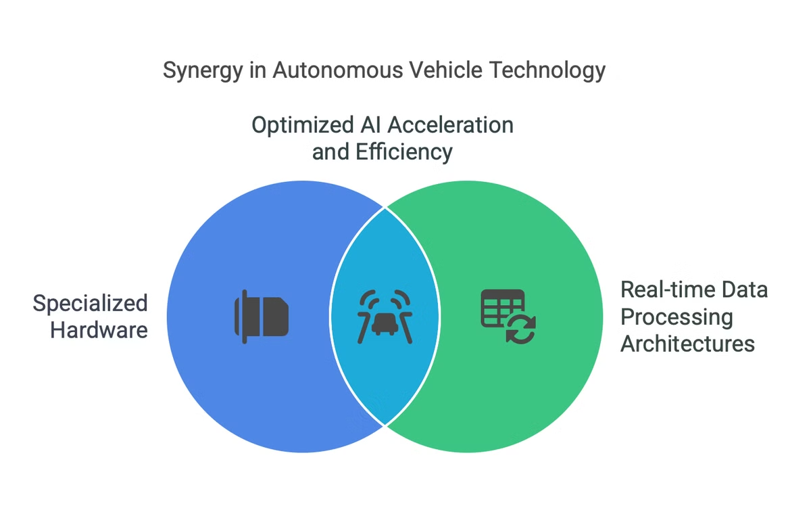
Literature Review
1
Context of Research
Evolution of specialized hardware for autonomous vehicles and progress in real-time data processing architectures.
2
Key Findings
Significant improvements in processing capabilities with custom hardware, such as the Tesla FSD chip.
3
Importance
Highlights the need for optimized AI acceleration, low latency, and high power efficiency in self-driving systems.

Slide 5



Architectural Analysis Overview
Key Components
2
Includes a custom instruction set architecture (ISA) and dual Neural Processing Units.
System-on-Chip Design
Custom-engineered for real-time data processing and optimized for deep neural network (DNN) processing.
1
Implementation
Features SRAM-based memory system and parallel computing implementation for lower latency.
3

Slide 6




Custom Instruction Set Architecture
Deterministic Execution
1
Low-latency execution for time-sensitive operations.
Custom AI Units
2
Tensor operations executed directly on-chip.
Enhanced Memory
3
Faster data retrieval.
Mathematical Optimizations
4
Qint8 = round(Wfp32 × S).
Optimized for vision and control systems, balancing performance and accuracy.

Slide 7

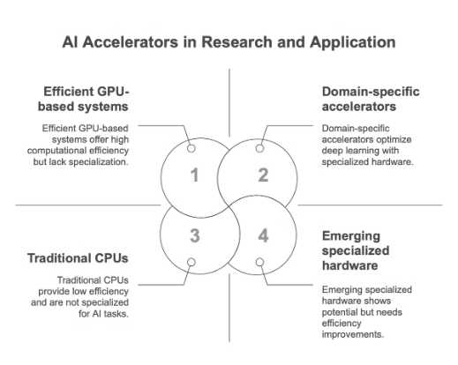



AI Accelerators
Current Research
Computational Efficiency
Research Implications
Domain-specific accelerators enhance deep learning tasks, reducing latency and power consumption.
Studies highlight computational efficiency advantages over GPUs, focusing on object recognition and route planning.
Growing trend toward specialized AI hardware, emphasizing processing speed, reliability, and safety.

Slide 8

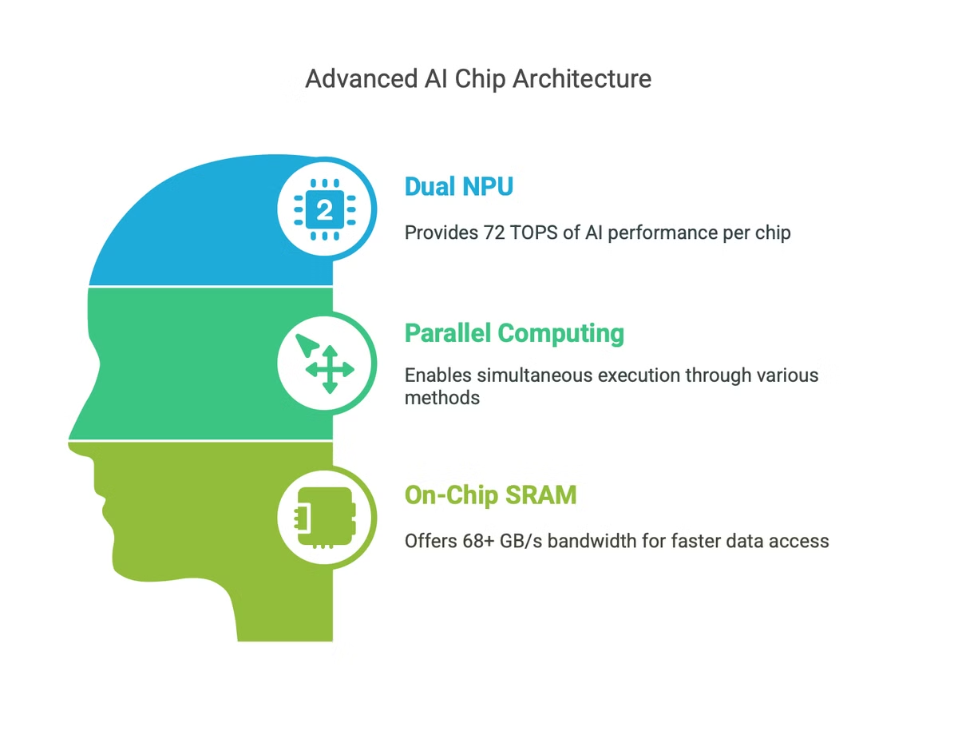



Neural Processing Architecture
Dual NPU
Parallel Computing
On-Chip SRAM
Each unit provides 36.86 TOPS, combining for 72 TOPS of AI performance per chip.
Caches with 68+ GB/s bandwidth for faster data access.
Instruction-Level, Data-Level Parallelism, and Pipelining for simultaneous execution.

Slide 9
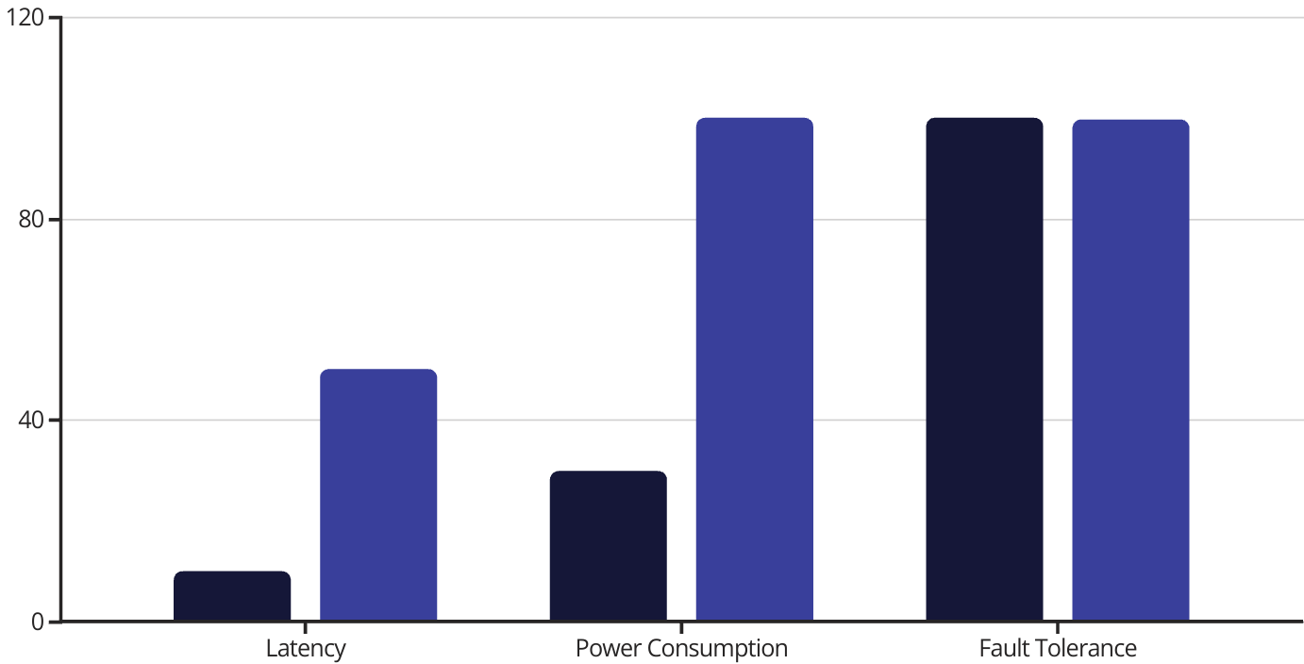
Performance Evaluation
FSD Chip
Traditional Hardware
Benchmarking against traditional hardware shows improved latency, power consumption, and fault tolerance.

Slide 10
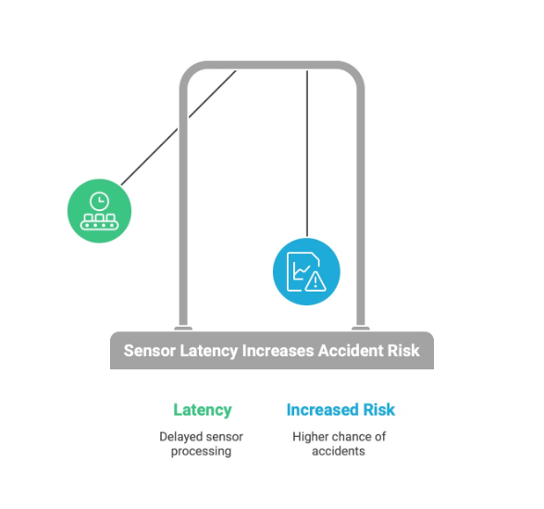
Latency Analysis
Critical Importance
Performance Findings
Delays in processing sensor input increase accident risk. Timely decision-making is essential for safety.
Custom instruction set significantly reduces computational overhead. SRAM-based architecture provides faster data retrieval.

Slide 11

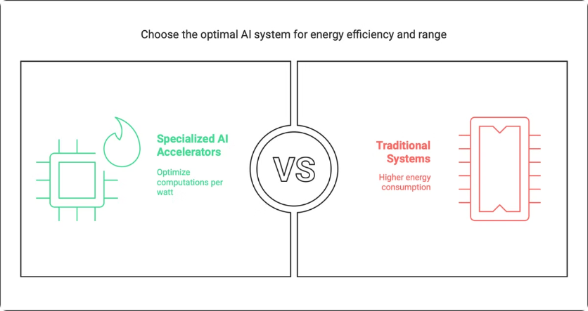
Power Efficiency & Fault Tolerance
1
Specialized AI Accelerators
2
Custom AI Inference Pipeline
Optimize computations per watt.
Enhances performance while consuming less energy.
3
Power Consumption
4
Vehicle Range
Approximately 36W per FSD chip.
Extends vehicle range compared to traditional systems.

Slide 12
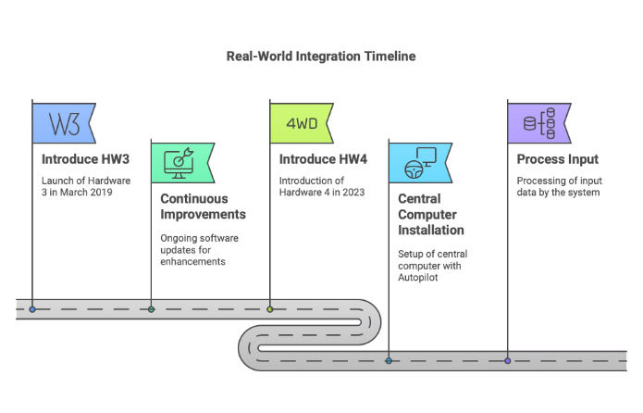
Real-World Integration
Implementation Timeline:
System Integration:
Introduced with Hardware 3 (HW3) in March 2019
Central computer installation alongside Autopilot components
Continuous improvements through software updates
Processing input
Hardware 4 (HW4) introduction in 2023

Slide 13
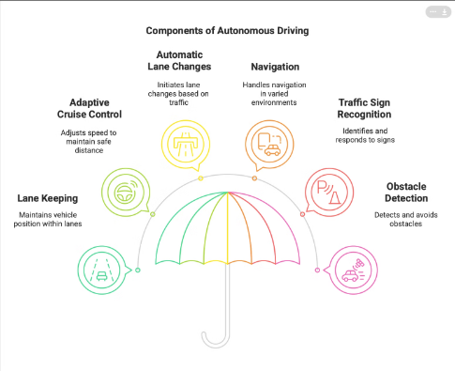
Autonomous Driving Features
1
Lane keeping and adaptive cruise control
2
Automatic lane changes in highway conditions
3
Navigation in complex environments
Maintains vehicle position within lane and adjusts speed to maintain safe distance.
Handles navigation in urban and rural areas with varying road conditions.
Initiates lane changes based on navigation and traffic flow.
4
Traffic light and sign recognition
5
Obstacle detection and avoidance
Identifies and responds to traffic signals and road signs.
Detects and avoids obstacles using sensor data.
Technical Implementation: Computer vision algorithms process sensor data from cameras and radar to create a 3D understanding of the environment, enabling the vehicle to make informed driving decisions.

Slide 14
Hardware Evolution
HW3 (2019)
1
First generation FSD chip with custom neural accelerators
2
HW4 (2023)
3-8× computational power increase compared to HW3. Enhanced sensor processing capabilities. Improved decision-making algorithms
HW5 (Expected 2026)
3
P

Slide 15
Conclusion
Key Contributions:
Sukhmani Thukral: Comprehensive literature review establishing research context
Namrata Mali: Detailed architectural analysis of custom instruction set
Likhitha Gudivada: Thorough performance evaluation revealing significant advantages
Priyanka Jaina: Clear explanation of Real-World Integration, Autonomous Driving Features, and Hardware Evolution
Research Significance: Tesla's FSD chip represents a paradigm shift in autonomous vehicle technology, establishing new benchmarks for specialized AI hardware.
Innovation Impact: The custom silicon architecture demonstrates how purpose-built hardware can significantly outperform general-purpose systems in autonomous driving applications.

Slide 16
References
Gamma App: https://gamma.app
Napkin AI: https://www.napkin.ai
TP02 Progress Submission Report

Slide 17

Q&A
Time for questions and discussion about the project.

